Slide 1


Introduction to Circuits Analysis
by Andrew G. Bell
abell118@ivytech.edu
(260) 481-2288
Lecture 7

Slide 2
CHAPTER 7
Basic Network Theorems

Slide 3
Network Theorem
Network: A complex combination of components
Theorem: Ideas or statements that are used to solve network problems

Slide 4
Network Theorem Assumptions
Linear networks
Steady-state conditions

Slide 5
Network Theorem
Today, computers perform network analysis in seconds.
Technicians need to know the basic concepts of each theorem.

Slide 6
Important Terms
Bilateral Resistance: Resistance having equal resistance in either direction.
Linear Network: A circuit whose electrical behavior does not change with different voltage or current values.
Steady-State Condition: The condition where circuit values and conditions are stable or constant.

Slide 7
Maximum Power Transfer Theorem
Maximum power transferred from the source to the load when R_{S} = R_{L}
R_{S} = source resistance
R_{L} = load resistance

Slide 8
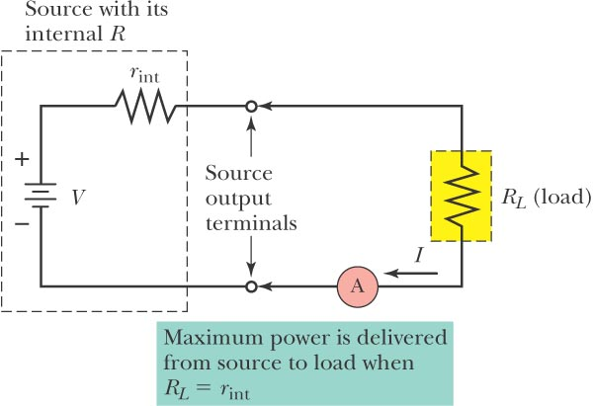
Series Circuit Example

Slide 9
Efficiency Factor
Measure of the percentage of power generated reaching the source.

Slide 10
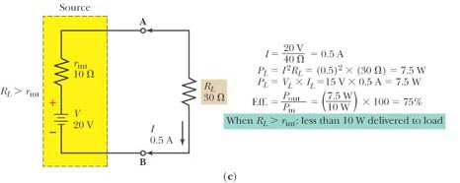
Example
Excel
Use Multisim and Excel to calculate the Pin and Pout values
Multisim

Slide 11
Summary of the
Maximum Power Transfer Theorem
Maximum power transfer occurs when R_{S} = R_{L}.
Efficiency at maximum transfer is 50%.
When R_{L} is greater than R_{S}, efficiency is larger than 50%.
When R_{L} is less than R_{S}, efficiency is less than 50%.

Slide 12
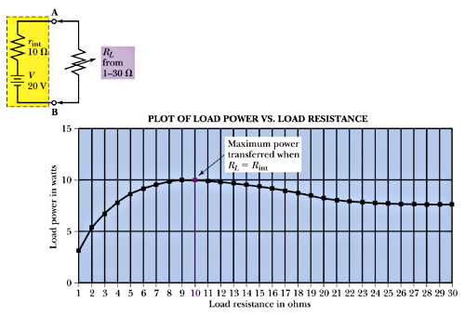
Power Versus R_{l}
Use Multisim and Excel to recreate the Plot of
Load Power vs Load Resistance
Excel
Multisim

Slide 13
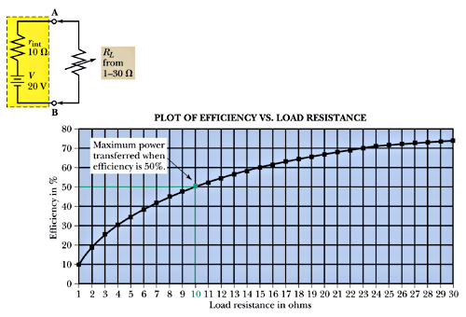
Efficiency Versus R_{l}

Slide 14
Superposition Theorem
Used when there are two or more voltage sources in a network.
There are three basic steps to the solution:

Slide 15
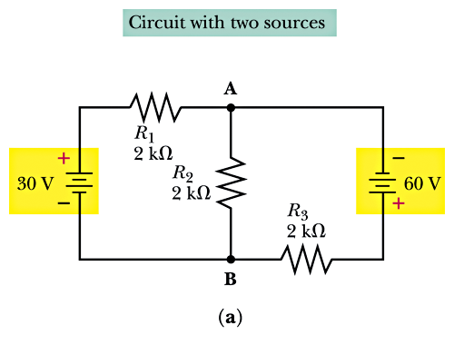
Example

Slide 16
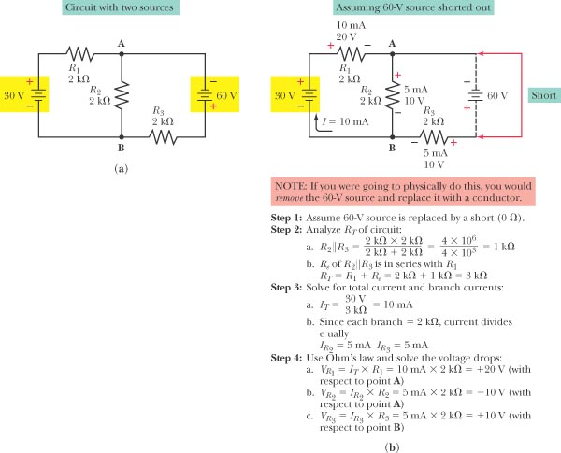
Superposition Theorem

Slide 17
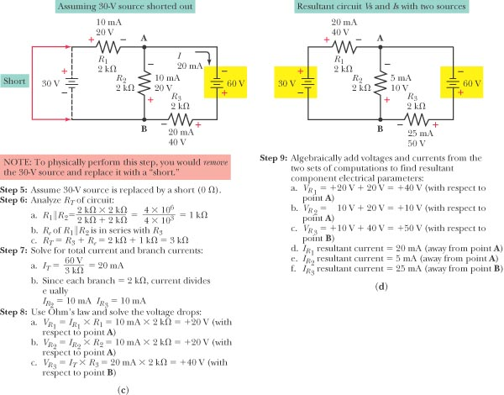
Superposition Theorem (cont.)

Slide 18
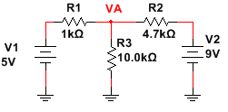
Superposition Theorem (cont.)
Excel
Multisim
Use Multisim and Excel to calculate the nodal voltage, Va, using Superposition

Slide 19
Summary of
Superposition Theorem
Ohm’s law is used to analyze the circuit using one source at a time.
Final results are determined by algebraically superimposing the results of all the sources involved.

Slide 20
Thevenin’s Theorem
A theorem used to simplify complex networks to determine circuit voltages and currents.
States that any linear two-terminal network can be replaced by a simplified equivalent circuit consisting of a single voltage source and a single series resistance.

Slide 21
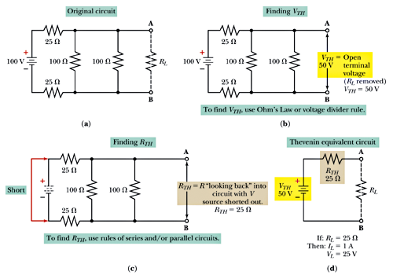
Thevenin’s Theorem Example
Excel
Multisim
Use Multisim and Excel to calculate the Thevenin equivalent circuit

Slide 22
Norton’s Theorem
Is used to reduce a two-terminal network to a single current source and a single parallel resistance.
Any linear two-terminal network can be replaced by an equivalent circuit consisting of a single current source and a single shunt or parallel resistance.

Slide 23
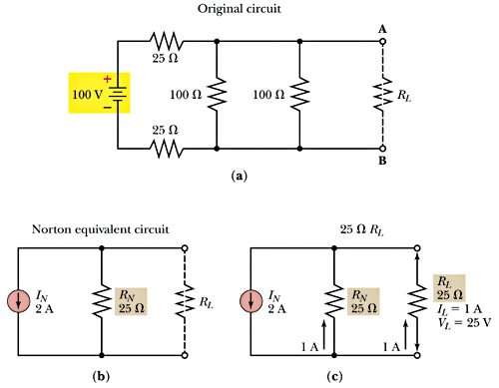
Norton’s Theorem Example

Slide 24
Relationship Between
Norton and Thevenin

